Slide 1
CIS9660: Data Mining for Business Analytics 1. From Business Problems to Data Mining Tasks
Foster Provost and Tom Fawcett. 2013. Data Science for Business: What you need to know about data mining and data-analytic thinking. Chapter 2
Notes:
https://baruch.az1.qualtrics.com/jfe/form/SV_0k264e1SBfjasyq

Slide 2

What is data mining?
Definition: Imp All
Data mining is a process that uses statistical, mathematical, and artificial intelligence techniques to extract and identify useful patterns from large sets of data. These patterns can be in the form of business rules, affinities, correlations, trends, or prediction models. (Nemati and Barko 2001)
Notes:
It appears that nowadays everything is talking about data mining. However, if you ask people what is data mining, some people may not have a clear idea about that. Before we talk more about data mining techniques, the first question we will have to answer is: what is data mining. This is the definition.
So, data mining is about looking for patterns in data. Why we want to find patterns? We highlight pattern because what we want to extract from data is not a one-time information. Instead, we want to know a pattern which will repeatedly appear in similar context. Useful patterns allow us to make nontrivial predictions on new data.
A scientist’s job (like a baby’s) is to make sense of data, to discover the patterns that govern how the physical world works and use this pattern for predicting what will happen in new situations. The entrepreneur’s job is to identify opportunities that they can turn the patterns into profit.

Slide 3
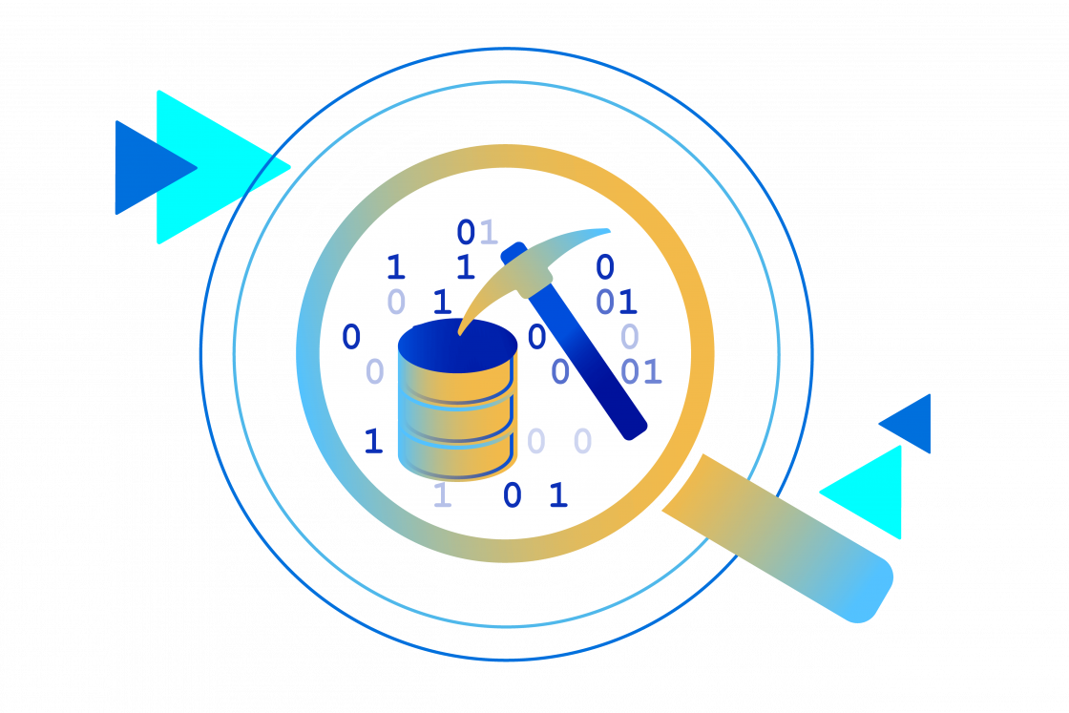
Why Data Mining
Society produces huge amounts of data
Sources: business, science, medicine, economics, geography, environment, sports, …
This data is a potentially valuable resource
Raw data is useless: need techniques to automatically extract information from it
Data: recorded facts
Information: patterns underlying the data

Slide 4

Supervised vs. Unsupervised Data Mining
Supervised:
--This method operates under supervision by being provided with the actual outcome for each of the training examples.
--Classification and regression
--e.g. find groups of customers who are more likely to cancel their orders
Unsupervised:
--No actual outcome is provided, and algorithms are left to their own devises to discover and present interesting patterns in the data
--Clustering and association rule mining
--e.g. categorize customers into different groups based on similarity
Notes:
The next concept is supervised and unsupervised data mining.
In a supervised data mining model, the algorithm do analysis on a labeled dataset (outcome), providing an answer key that the algorithm can use to evaluate its accuracy on training data. The process of an algorithm learning from the training dataset can be thought of as a teacher supervising the learning process. We know the correct answers, the algorithm iteratively makes predictions on the training data and is corrected by the teacher. Learning stops when the algorithm achieves an acceptable level of performance.
For example, classification and regression are both supervised data mining.
Classification: A classification problem is when the output variable is a category, such as “red” or “blue” or “disease” and “no disease”.
Regression: A regression problem is when the output variable is a real value, such as “dollars” or “weight”.
An unsupervised model, in contrast, provides unlabeled data that the algorithm tries to make sense of by extracting features and patterns on its own. Unsupervised learning is where you only have input data and no corresponding output variables.
The goal for unsupervised learning is to model the underlying structure or distribution in the data in order to learn more about the data.
These are called unsupervised learning because unlike supervised learning above there is no correct answers and there is no teacher. Algorithms are left to their own devises to discover and present the interesting structure in the data.
Unsupervised learning problems can be further grouped into the clustering problems and association problems.
Usually, what we will come across is a combination of being supervised and unsupervised. You can also transform one type into another type. And, to solve a problem, you can use both supervised or unsupervised methods, depending on how you cast the business problems into data mining tasks.

Slide 5
Four Data Mining Techniques We Will Be Doing in this Class
Decision Trees
Clustering
Association Rules
Regressions

Slide 6
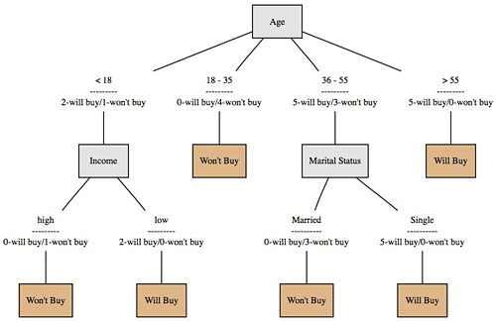
Decision Tree
Decision tree is a decision support tool that uses a tree-like graph or model of decisions and their possible consequences, including chance event outcomes, resource costs, and utility.
http://www.mindtoss.com/2010/01/25/five-second-rule-decision-chart/
Application
Determine whether an investment will pay off
Predict whether a customer will default
Determine the species of an animal
Notes:
Usually, decision tree is a supervised data mining. It predicts whether something will happen.

Slide 7
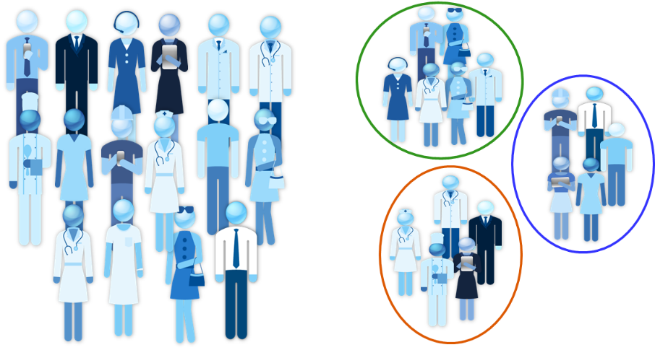
Clustering
Used to group similar items together
Based on similarities between objects, or alternatively distance between objects
Application
Identify similar customers or similar products for recommendations
Optimize good delivery by finding the optimal number of launch locations
Detect insurance or credit card fraud

Slide 8
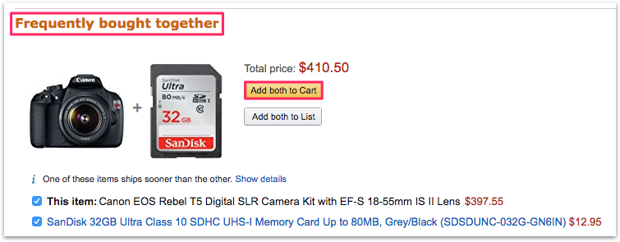
Association Rule Mining
Find out which events or items go together
Application
What products are bought together?
Amazon’s recommendation engine
Medical diagnosis

Slide 9
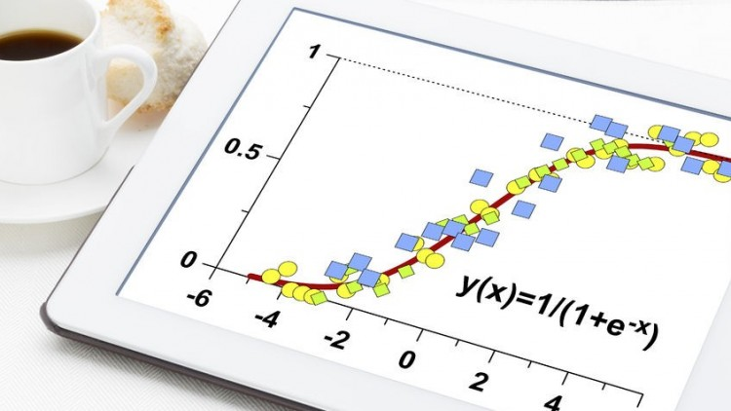
Regression
Regression is a statistical method that allows you to examine the relationship between two or more variables of interest.
http://www.mindtoss.com/2010/01/25/five-second-rule-decision-chart/
Application
Test hypotheses
Estimate the correlation between events
Predict future sales based on historical data

Slide 10
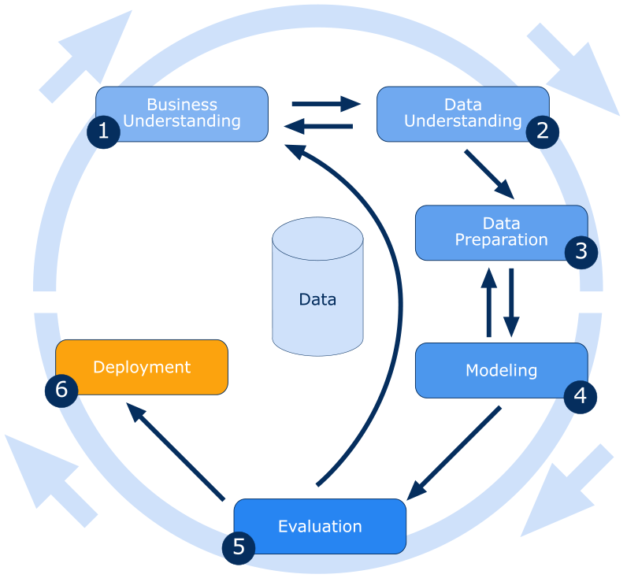
The Data Mining Process:
The CRIPS (Cross Industry Standard Process) Data Mining Process
https://www.icas.com/ca-today-news/10-companies-using-big-data
Notes:
Here we have a useful codification of the process given by the cross industry standard process for data mining. We can see there are six steps during the process: business understanding, data understanding, data preparation, modeling, evaluation, and deployment.
In most cases, going through the process once without solving the problem is not a failure; as the process diagram makes explicit the fact that iteration is the rule rather than the exception. Often, the entire process is an exploration of the data, and after the first iteration, the data science team knows more about the problem so that the next iteration can be much more well-informed.

Slide 11
The Data Mining Process:
Business Understanding:
Understand the business context
Cast a business problem as one or more data science problems;
The design team should think carefully about the problem to be solved and about the use scenario.
The CRIPS (Cross Industry Standard Process) Data Mining Process
https://www.icas.com/ca-today-news/10-companies-using-big-data
Notes:
The first step is to understand the problem to be solved. This may seem obvious, but business projects seldom come pre-packaged as clear and unambiguous data mining problems.
This is where the analysts’ creativity plays a large role. Often, the key to a great success is a creative problem formulation by some analysis regarding how to cast the business problem as one or more data science problems.
Here, the design team should think carefully about the problem to be solved and about the use scenario.
Why we need to think about the use scenario? Because we usually analyze a problem in a specific context and our finding may not work in another context. For example, we want to test how online reviews affect sales, and we find that online reviews help increase sales on Walmart. However, the same relationship may not be supported when we looked at the sales of iPhone. Because, people have may other way to know an iPhone product, and in this case online reviews may not be appreciated.

Slide 12


Example 1:
How to transform this business problem into a data mining problem:
Do ride-hailing companies like Uber and Lyft make a city's traffic worse or better?
Regression
Dependent variable: how to measure the performance of city traffic?
Explanatory variable
Correlation or causality?
https://www.icas.com/ca-today-news/10-companies-using-big-data
Notes:
The first question is: Do ride-hailing companies like Uber and Lyft make a city's traffic worse or better?
How can we answer this question? This is a typical relation question, in which the output of the analysis would be a causal relation between two variables. The explanatory variable and the dependent variable. The explanatory variable is the variable that explains variations in the dependent variable.
For example, in this question, something related to Uber and Lyft is our explanatory variable and city’s traffic is our response variable.
Ok, then, the next step is to be more specific about these two variables. In another word, we need to find one number for each of them.
We decide to use whether Uber/Lyft enter a city as our exoplanetary variable, and we need a measure to describe a city’s traffic. Any ideas?
We can use the number of car accidents, the number of death each year in the city, the average speed of traffic on each day to describe a city’s traffic. Essentially, whenever Uber and Lyft enters a city, we see the number of car accidents increases, the number of deaths each year in the city increases, or the average speed of traffic on each day decreases. We can possibly conclude that Uber and Lyft make the city’s traffic worse.
Why I use the word “possible” here? Why we can only possibly conclude that Uber and Lyft make the city’s traffic worse? Because correlation does not always imply causality. For example, maybe Uber chose to enter a city if it see economic development in that city. And city underdoing economic development are likely to see their traffic getting worse. In this case, the really reason for the worse traffic is the economic development in the city, rather than Uber entry.
This example tells us that when answer business questions, especially when we try to identify causal effect of one event, we should be careful about many other possibilities.
Get back to the previous example of Uber, now we know that economic development in the city may be the reason of Uber entry and a worse traffic, what can we do to fix the analysis? We can add economic development as a control variable in the regression to account for the potential influence of economic development.
Ok, assuming that we have accounted for the influence of economic development in the model, is there anything else that may influence both our explanatory and response variable?
There are many other factors, such as population in a city, city policies for companies, city traffic…. Not controlling for these factors will lead to an incorrect estimation of the effect of Uber/Lyft on city traffic.
In this class, we will learn how to deal with these issues and conduct the right analysis.

Slide 13

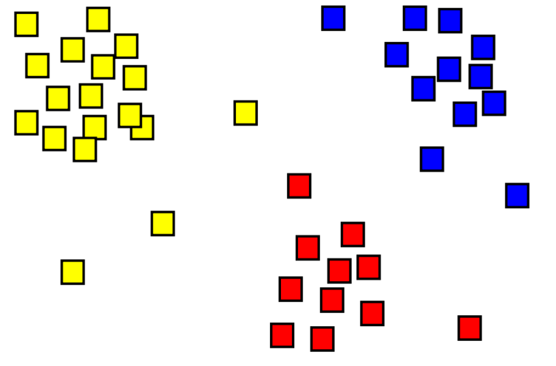
Example 2:
How to transform this business problem into a data mining problem:
How can investors build a diversified portfolio?
Clustering
How to define diversified portfolio?
https://www.icas.com/ca-today-news/10-companies-using-big-data
Notes:
How can we answer this question?
This is a typical question for clustering analysis. As in this question, we are not seeking for a relationship. Instead, we are trying to split investment products into different smaller groups.
To do this, we need to answer one question: how to define diversified portfolio? For example, we can define a portfolio as diversified portfolio, if the investment products in it have different levels of Risks, prices, from different industries….. Each analyst can have their own definition of diversified portfolio based on their understanding and goal of this analysis.
Assuming now we have a bunch of investment product and a definition of diversified portfolio based on risks and costs (we want to have products with different risks and costs). How can we do it? We will calculate how different each investment product is from each other based on their risk and cost levels, and group together those which are close to each other. And next, we will pick one from each group to form the diversified portfolio.

Slide 14
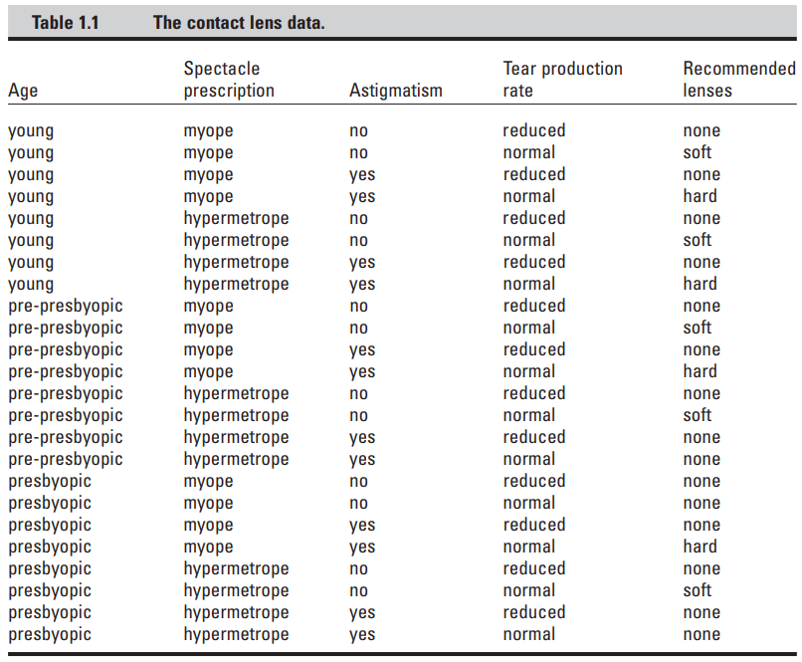
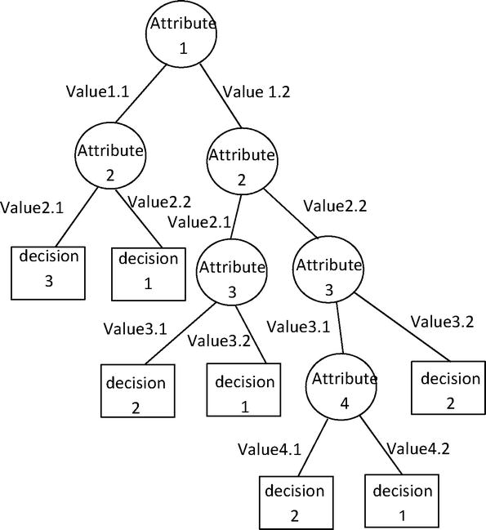
Example 3:
How to transform this business problem into a data mining problem:
How does an optician recommend lenses?
Decision tree
What factors would be considered when opticians recommend lenses?
https://www.icas.com/ca-today-news/10-companies-using-big-data
Notes:
How to answer this question?
This is a typica decision tree problems. As the decision is determined by the combination of many factors.
Let's start with one simple question. What factors should be considered when opticians recommend lenses?
According to this table, we have age, spectacle prescription, astigmatism, and tear production rate.
We can see that recommendation of lenses depends on many factors and no single factor can give us a clear answer.
To answer this question, we will use a decision tree in which we will start with a starting node, and split the node with each factor.

Slide 15
The Data Mining Process:
Data Understanding:
Understand the strengths and limitations of the data;
Estimate the costs and benefits of each data source and decide whether further investment is merited;
The CRIPS (Cross Industry Standard Process) Data Mining Process
https://www.icas.com/ca-today-news/10-companies-using-big-data
Notes:
The second step is data understanding. We need to understand the data in two ways:
First, we need to Understand the strengths and limitations of the data;
It is important to Understand the strengths and limitations of the data because rarely we can find data exactly match with the problem.
-Historical data often are collected for purposes unrelated to the current business problems, or for no explicit purpose at all. So we need to understand data before we do analysis.
Second, we need to Estimate the costs and benefits of each data source and decide whether further investment is necessary;
This step is important as The costs of data may vary
-Some data is available for free while others will require effort to obtain, and some could be very expensive

Slide 16
The Data Mining Process:
Data Preparation:
Collect and clean data
Manipulate and convert data into forms that yield better results
The CRIPS (Cross Industry Standard Process) Data Mining Process
https://www.icas.com/ca-today-news/10-companies-using-big-data
Notes:
The third step is data preparation; in which we collect and clean data. The goal is to Manipulate and convert data into forms that yield better results
-e.g., converting data to the right format, removing or inferring missing values, and converting data to different types

Slide 17
The Data Mining Process:
Modeling:
Apply data mining techniques to the data
No universally best methods or algorithms for data mining tasks
The CRIPS (Cross Industry Standard Process) Data Mining Process
https://www.icas.com/ca-today-news/10-companies-using-big-data
Notes:
In the fourth step, we will apply data mining techniques to do the analysis. This is the primary place where data mining techniques are applied to the data.
One thing to note is that there are No universally best methods or algorithms for data mining tasks. We need to select the most suitable techniques based on the problems.

Slide 18
The Data Mining Process:
Evaluation:
Assess the data mining results rigorously and evaluate if they are valid and reliable before moving on
Easier, cheaper, quicker, and safer to test a model first in a controlled laboratory setting
The CRIPS (Cross Industry Standard Process) Data Mining Process
https://www.icas.com/ca-today-news/10-companies-using-big-data
Notes:
The fifth step is evaluation, in which we will Assess the data mining results rigorously and evaluate if they are valid and reliable before moving on
If we look hard enough at any dataset, we will find some patterns, but they may not make sense or survive in another context.
Equally important, the evaluation stage also serves to help ensure that the model satisfies the original business goals.
It can be both quantitative and qualitative.
It is inadvisable to deploy results immediately after data mining.
It is always Easier, cheaper, quicker, and safer to test a model first in a controlled laboratory setting. However, sometimes we cannot do lab experiment, so we have to rely on other methods. For example, if we want to know whether education influence income. The experiment would be we have two groups, one control group in which no one can go to college, and the other one is a controlled group in which we require everyone to go to college. As you can see this is impractical.

Slide 19
The Data Mining Process:
Deployment:
The results of data mining—and increasingly the data mining techniques themselves– are put into real use in order to realize return on investment
Often return to the Business Understanding phase for a second iteration, which can yield an improved solution;
Results are not always worth deploying
The CRIPS (Cross Industry Standard Process) Data Mining Process
https://www.icas.com/ca-today-news/10-companies-using-big-data
Notes:
The last step is deployment in which The results of data mining are put into real use in order to realize return on investment
It is not necessary to fail in deployment to start the cycle again; the evaluation stage may reveal that results are not good enough to deploy, and we need to adjust the problem definition or get different data;

Slide 20
Problems of Data Mining
Real data is imperfect
Some parts will be garbled, and some will be missing
Many patterns will be banal and uninteresting. Others will be spurious, contingent on accidental coincidences in the particular dataset used.
Anything discovered will be inexact
There will be exceptions to every rule and cases not covered by any rule
Algorithms need to be robust enough to cope with imperfect data and to extract regularities that are inexact but useful.
We also need to keep in mind that the data to which we will apply data science techniques are the product of some process that involved human decisions. We should not think that the data represent objective truth.
Notes:
Data incorporate the beliefs, purposes, biases, and pragmatics of those who designed the data collection systems. The meaning of data is colored by our own beliefs.
Data is a complement to “intuition” or past experience – Not a substitute

Slide 21

Practice:
Using data mining techniques to answer the following question: Is Grad School Worth the Cost?
Transform the problem into a data mining problem
Where can you get data for the analysis
How can you evaluate your analysis?
https://www.icas.com/ca-today-news/10-companies-using-big-data
Notes:
This is a Practice question. Think about how can we calculate the economic return to graduate studies.
Transform the problem into a data mining problem:
-What is the effect of having a graduate degree on individuals’ annual income?
-regression, dependent variable (annual income), explanatory variable (before/after someone got a graduate degree).
-causality
Where can you get data?
--LinkedIn
--Glassdoor
How to evaluate your analysis?
--Experiment (?)
--Test and validation
--Replicate analysis using different models and different data

Slide 22
Install Python and PyCharm
https://www.youtube.com/watch?v=kqtD5dpn9C8
Install Packages in PyCharm
https://www.youtube.com/watch?v=zCO3KxV2zPI

